Slide 1
Convolutional neural networks and Long Short-Term Memory
Dr. Shahid Ismail

Slide 2
CNN’s Topology
Feature maps
C
Feature extraction layer
Convolution layer
Shift and distortion invariance or
Subsampling layer
S

Slide 3



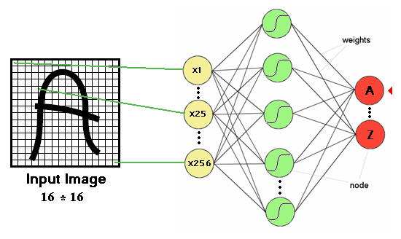

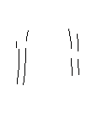

Feature extraction layer or Convolution layer
detect the same feature at different positions in the input image.
features

Slide 4










Subsampling layer

Slide 5
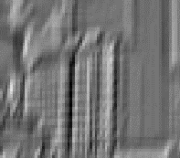

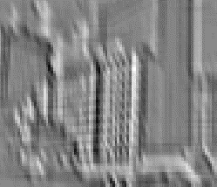


Convolutional neural network Convolution?
Weighted moving sum
...
Input
Feature Activation Map
slide credit: S. Lazebnik

Slide 6
Convolutional Neural Networks
Feature maps
Normalization
Spatial pooling
Non-linearity
Convolution (Learned)
Input Image
slide credit: S. Lazebnik

Slide 7
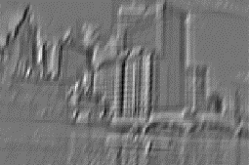

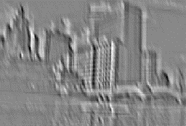
Convolutional Neural Networks
Feature maps
Normalization
Spatial pooling
Non-linearity
...
Convolution (Learned)
Input
Feature Map
Input Image
slide credit: S. Lazebnik

Slide 8
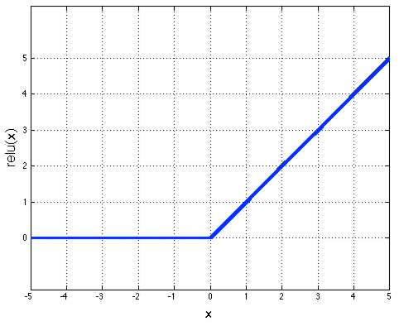
Convolutional Neural Networks
Feature maps
Normalization
Rectified Linear Unit (ReLU)
Spatial pooling
Non-linearity
Convolution (Learned)
Input Image
slide credit: S. Lazebnik

Slide 9
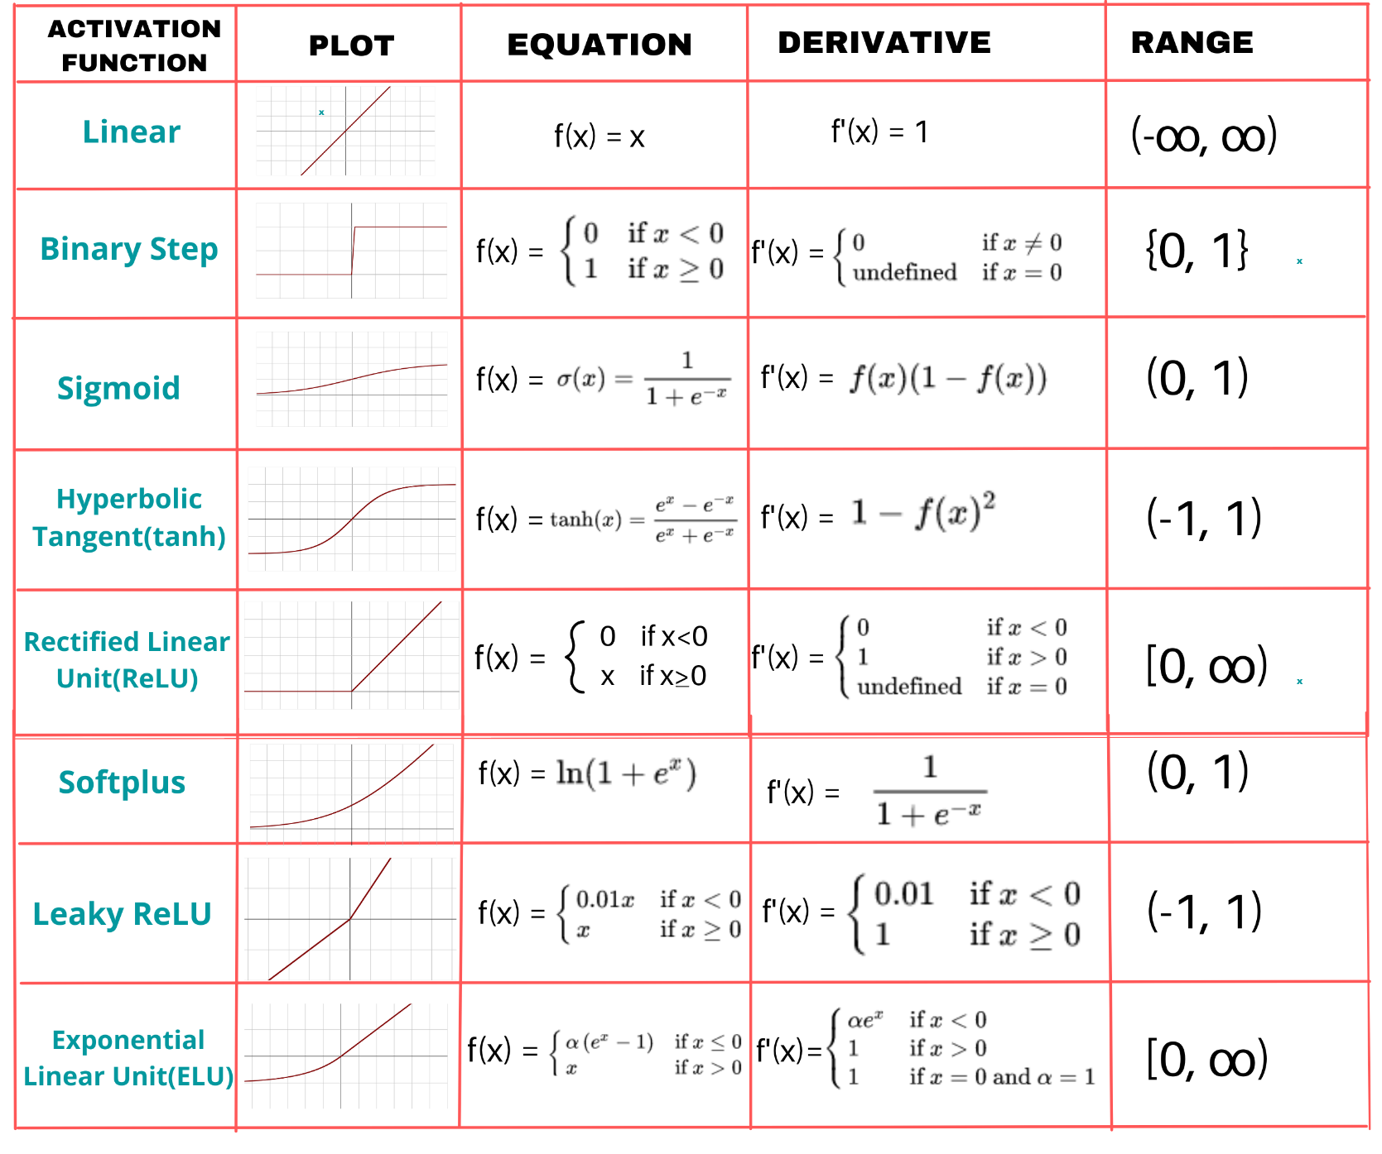
Activation functions

Slide 10
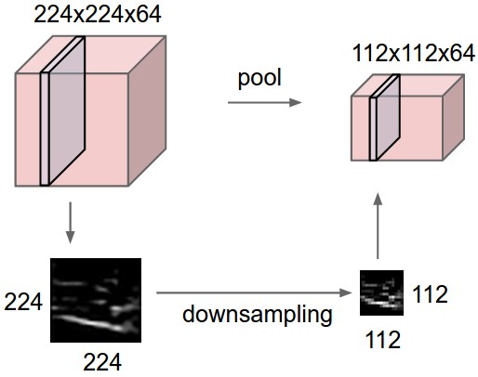
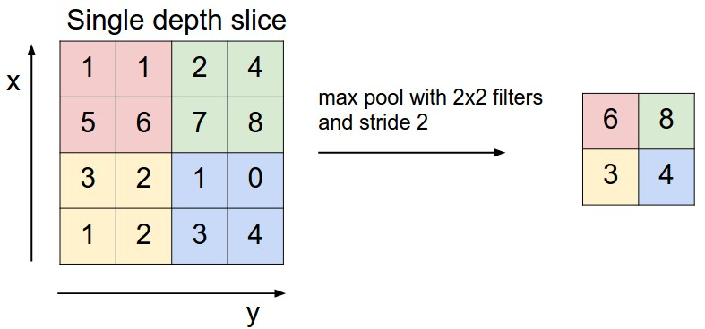
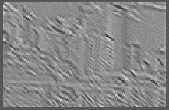

Convolutional Neural Networks
Feature maps
Normalization
Max pooling
Spatial pooling
Non-linearity
Convolution (Learned)
Max-pooling: a non-linear down-sampling Provide translation invariance
Input Image
slide credit: S. Lazebnik

Slide 11
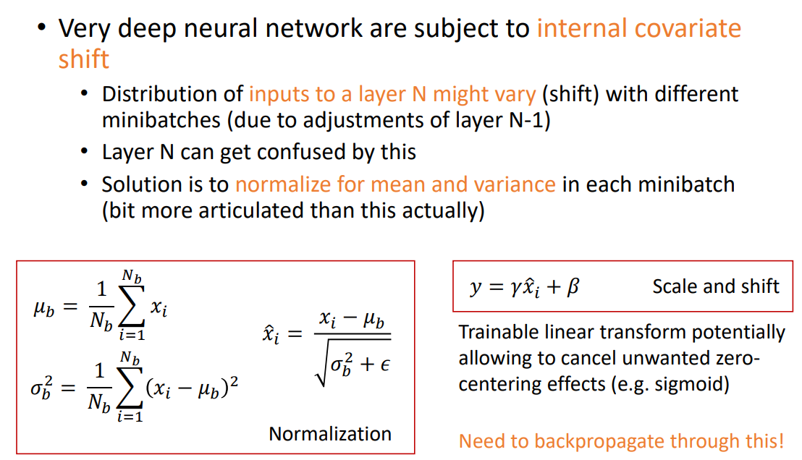
Convolutional Neural Networks
Feature maps
Normalization
Spatial pooling
Non-linearity
Convolution (Learned)
Input Image
slide credit: S. Lazebnik

Slide 12
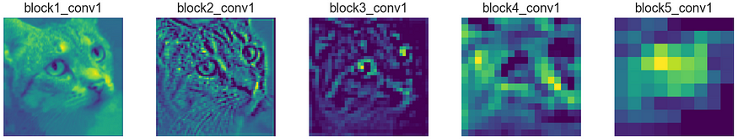
Convolutional Neural Networks
Feature maps
Normalization
Spatial pooling
Non-linearity
Convolution (Learned)
Input Image
slide credit: S. Lazebnik

Slide 13
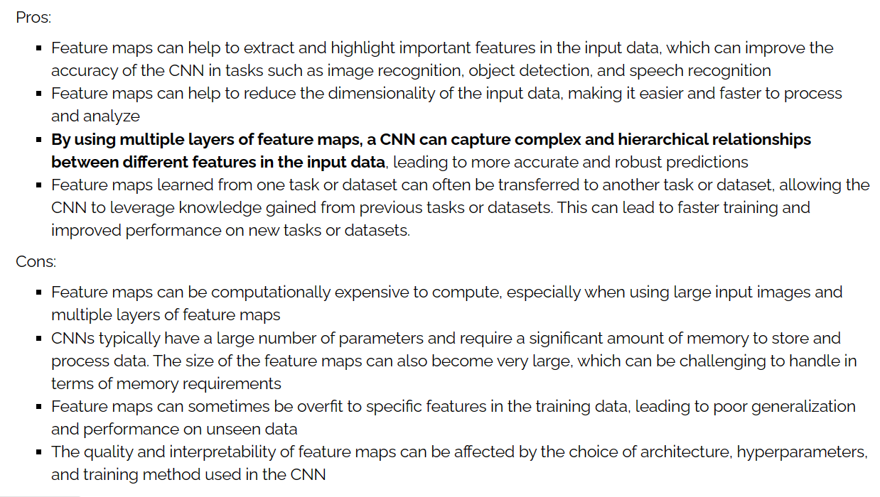
Convolutional Neural Networks
Feature maps
Normalization
Spatial pooling
Non-linearity
Convolution (Learned)
Input Image
slide credit: S. Lazebnik

Slide 14
Engineered vs. learned features
Label
Convolutional filters are trained in a supervised manner by back-propagating classification error
Dense
Dense
Dense
Convolution/pool
Label
Convolution/pool
Classifier
Convolution/pool
Pooling
Convolution/pool
Feature extraction
Convolution/pool
Image
Image
Jia-Bin Huang and Derek Hoiem, UIUC

Slide 15
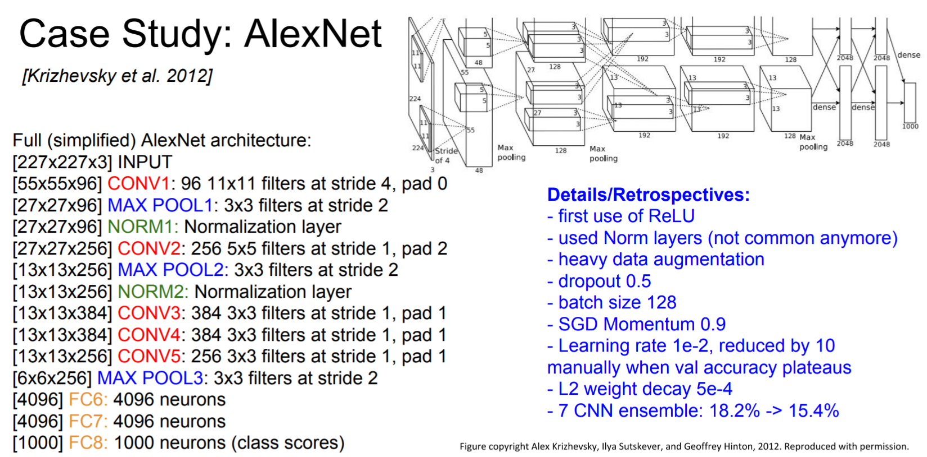
AlexNet 2012
A strong prior has very low entropy, e.g. a Gaussian with low variance
An infinitely strong prior says that some parameters are forbidden, and places zero probability on them
The convolution ‘prior’ says the identical and zero weights
The pooling forces the invariance of small translations

Slide 16
AlexNet
Input: 227x227x3 images (224x224 before padding)
First layer: 96 11x11 filters applied at stride 4
Output volume size?
(N-F)/s+1 = (227-11)/4+1 = 55 -> [55x55x96]
Number of parameters in this layer?
(11*11*3)*96 = 35K
Slide taken from Fei-Fei & Justin Johnson & Serena Yeung. Lecture 9.
[Krizhevsky et al., 2012]

Slide 17
AlexNet
Input: 227x227x3 images (224x224 before padding)
After CONV1: 55x55x96
Second layer: 3x3 filters applied at stride 2
Output volume size?
(N-F)/s+1 = (55-3)/2+1 = 27 -> [27x27x96]
Number of parameters in this layer?
0!
Slide taken from Fei-Fei & Justin Johnson & Serena Yeung. Lecture 9.
[Krizhevsky et al., 2012]

Slide 18
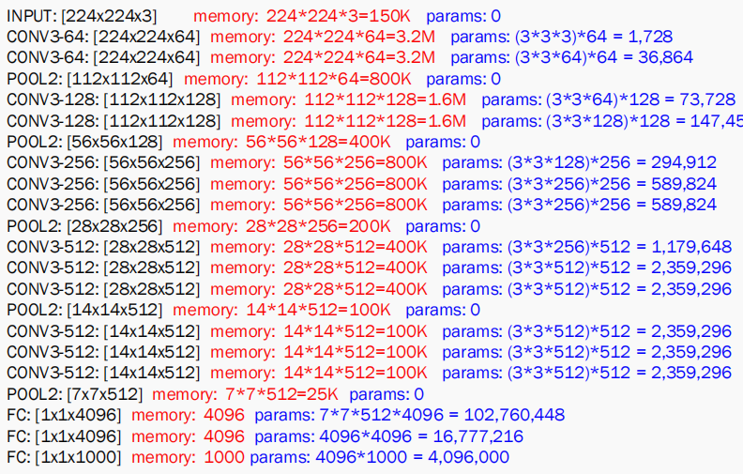
AlexNet: Parameters and Memeory

Slide 19
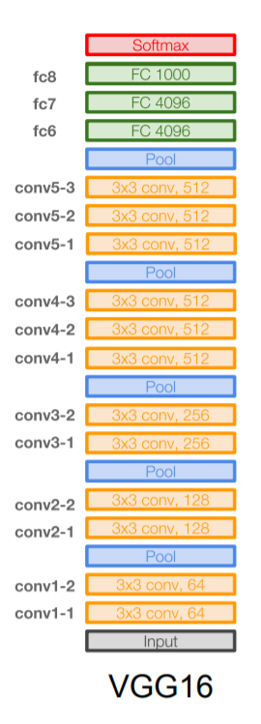
VGGNet
Input memory: 224*224*3=150K params: 0
3x3 conv, 64 memory: 224*224*64=3.2M params: (3*3*3)*64 = 1,728
3x3 conv, 64 memory: 224*224*64=3.2M params: (3*3*64)*64 = 36,864
Pool memory: 112*112*64=800K params: 0
3x3 conv, 128 memory: 112*112*128=1.6M params: (3*3*64)*128 = 73,728
3x3 conv, 128 memory: 112*112*128=1.6M params: (3*3*128)*128 = 147,456
Pool memory: 56*56*128=400K params: 0
3x3 conv, 256 memory: 56*56*256=800K params: (3*3*128)*256 = 294,912
3x3 conv, 256 memory: 56*56*256=800K params: (3*3*256)*256 = 589,824
3x3 conv, 256 memory: 56*56*256=800K params: (3*3*256)*256 = 589,824
Pool memory: 28*28*256=200K params: 0
3x3 conv, 512 memory: 28*28*512=400K params: (3*3*256)*512 = 1,179,648
3x3 conv, 512 memory: 28*28*512=400K params: (3*3*512)*512 = 2,359,296
3x3 conv, 512 memory: 28*28*512=400K params: (3*3*512)*512 = 2,359,296
Pool memory: 14*14*512=100K params: 0
3x3 conv, 512 memory: 14*14*512=100K params: (3*3*512)*512 = 2,359,296
3x3 conv, 512 memory: 14*14*512=100K params: (3*3*512)*512 = 2,359,296
3x3 conv, 512 memory: 14*14*512=100K params: (3*3*512)*512 = 2,359,296
Pool memory: 7*7*512=25K params: 0
FC 4096 memory: 4096 params: 7*7*512*4096 = 102,760,448
FC 4096 memory: 4096 params: 4096*4096 = 16,777,216
FC 1000 memory: 1000 params: 4096*1000 = 4,096,000
Slide taken from Fei-Fei & Justin Johnson & Serena Yeung. Lecture 9.
[Simonyan and Zisserman, 2014]

Slide 20
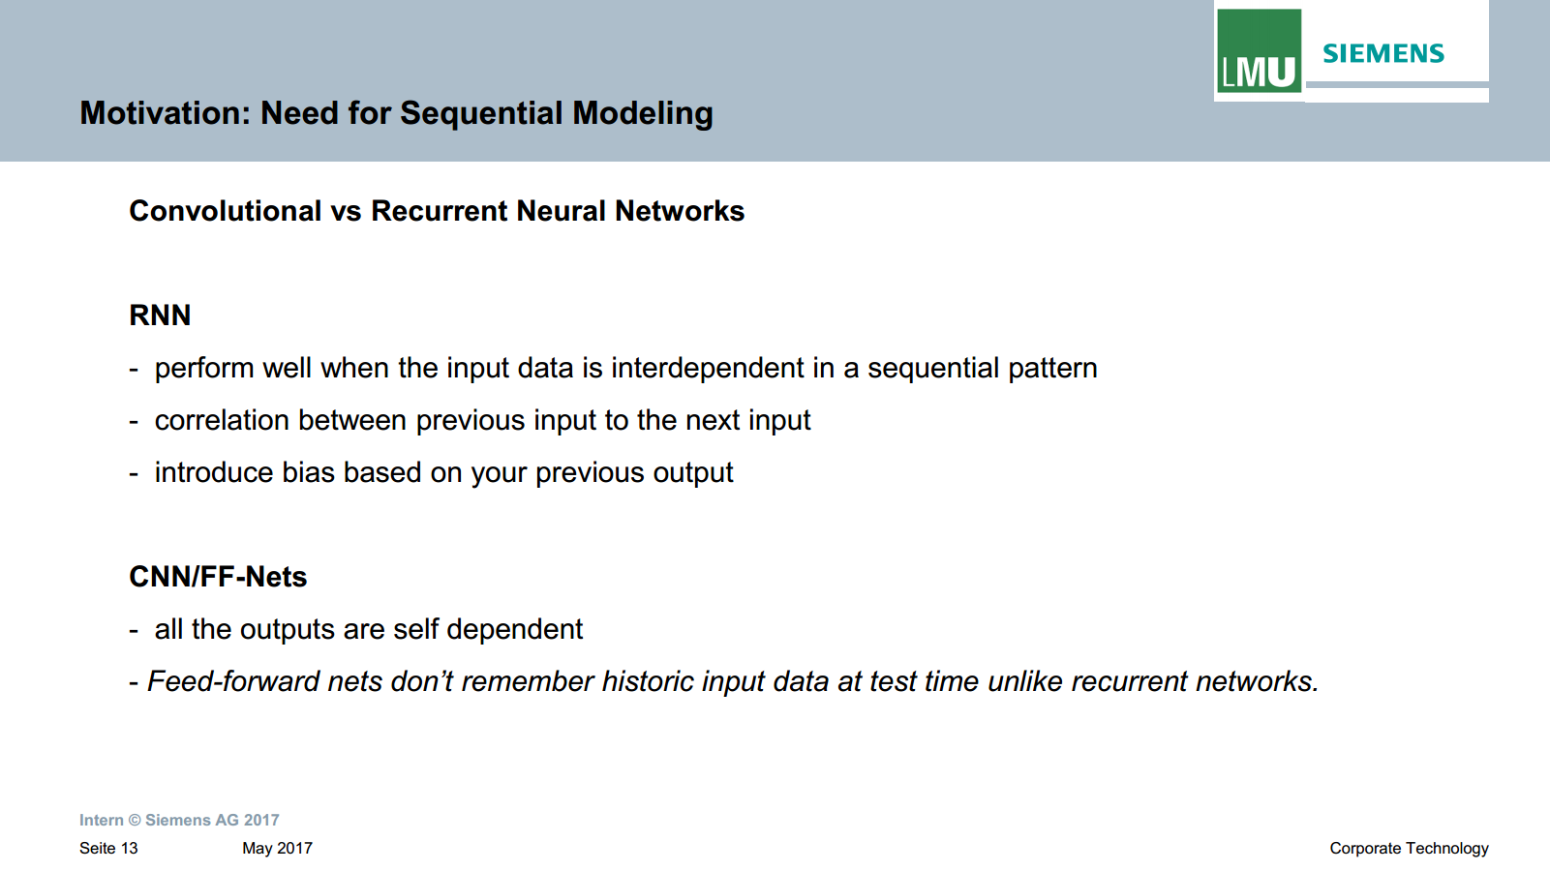

Slide 21
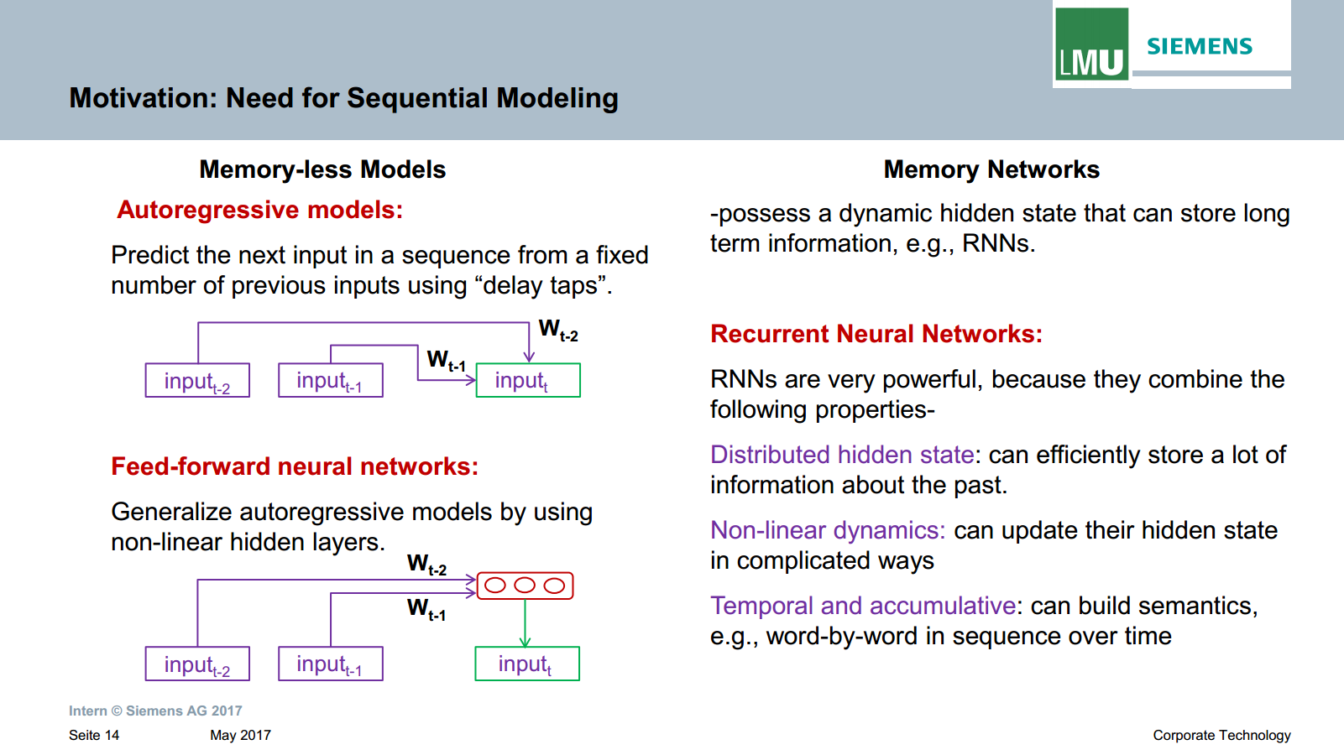

Slide 22
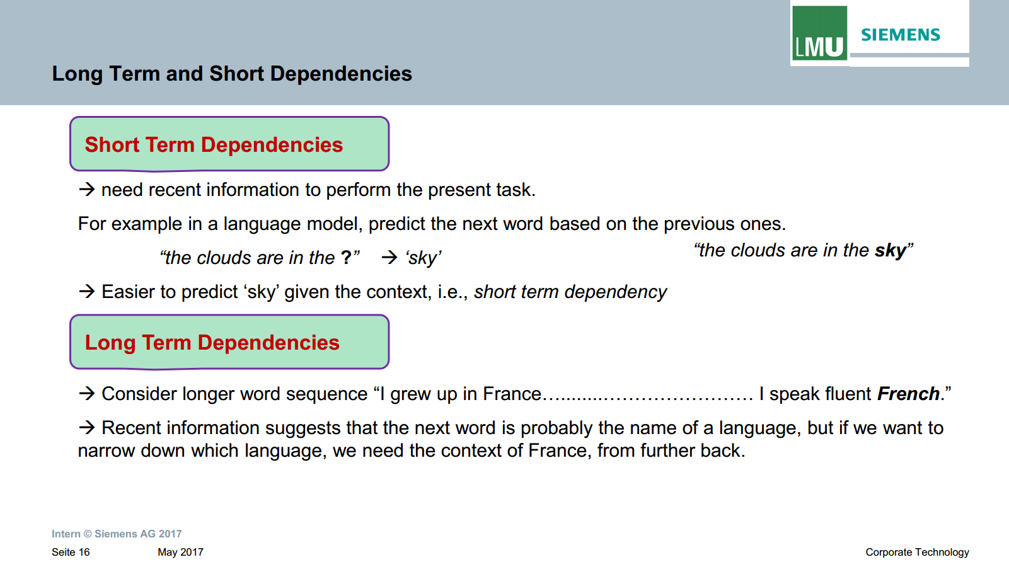

Slide 23
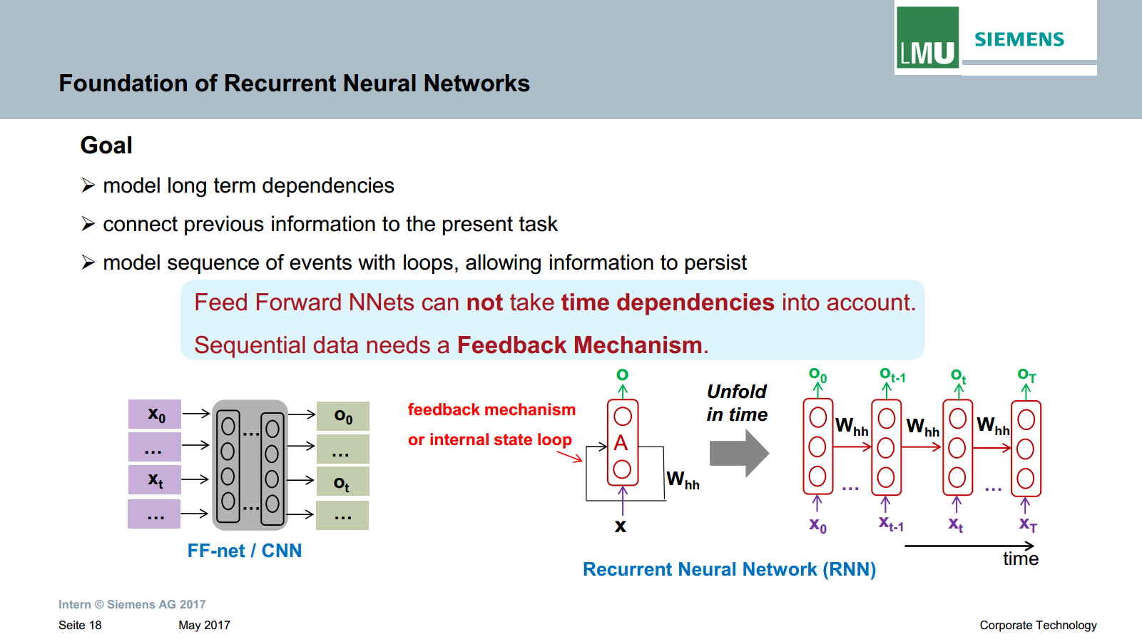

Slide 24
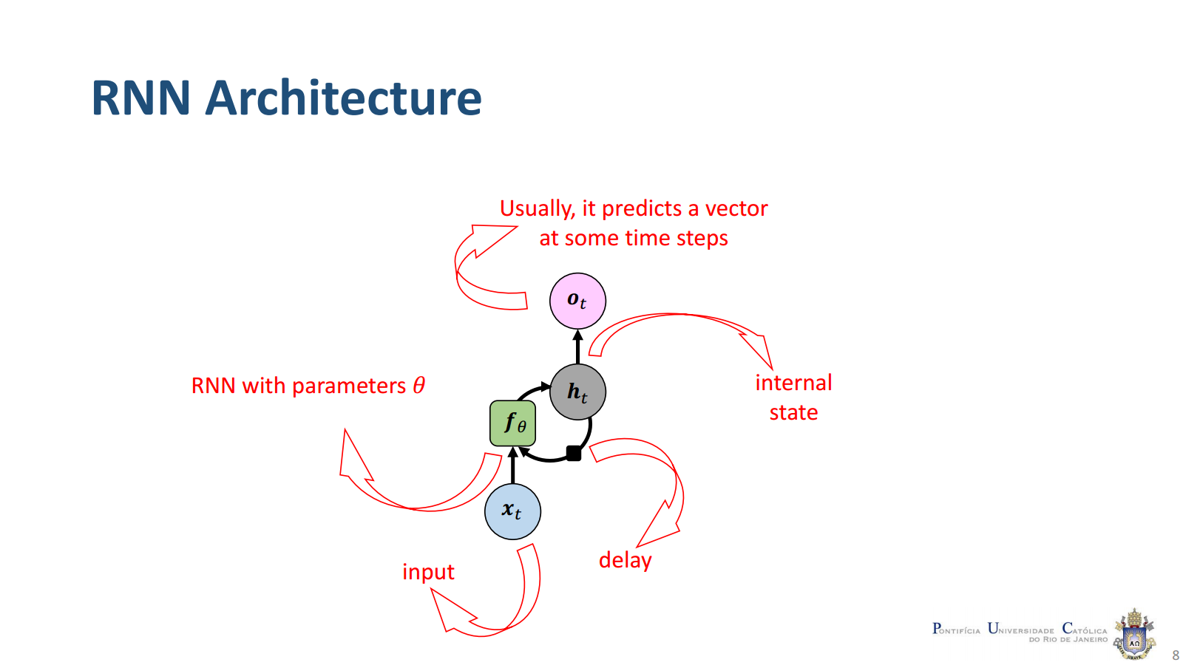

Slide 25
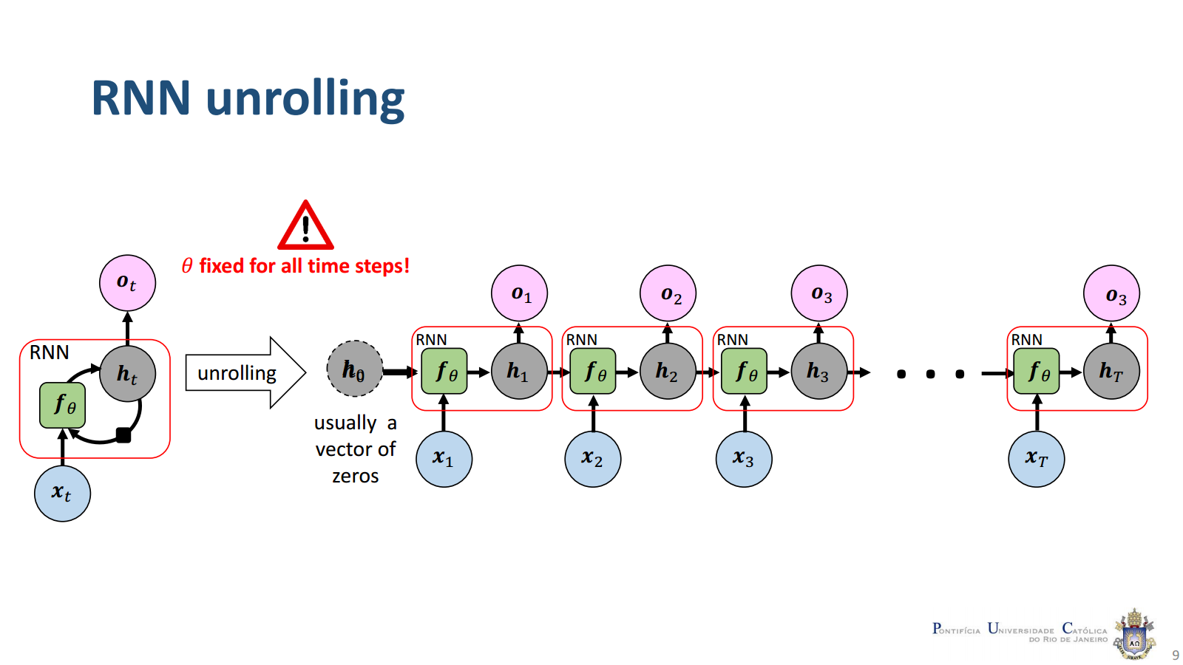

Slide 26
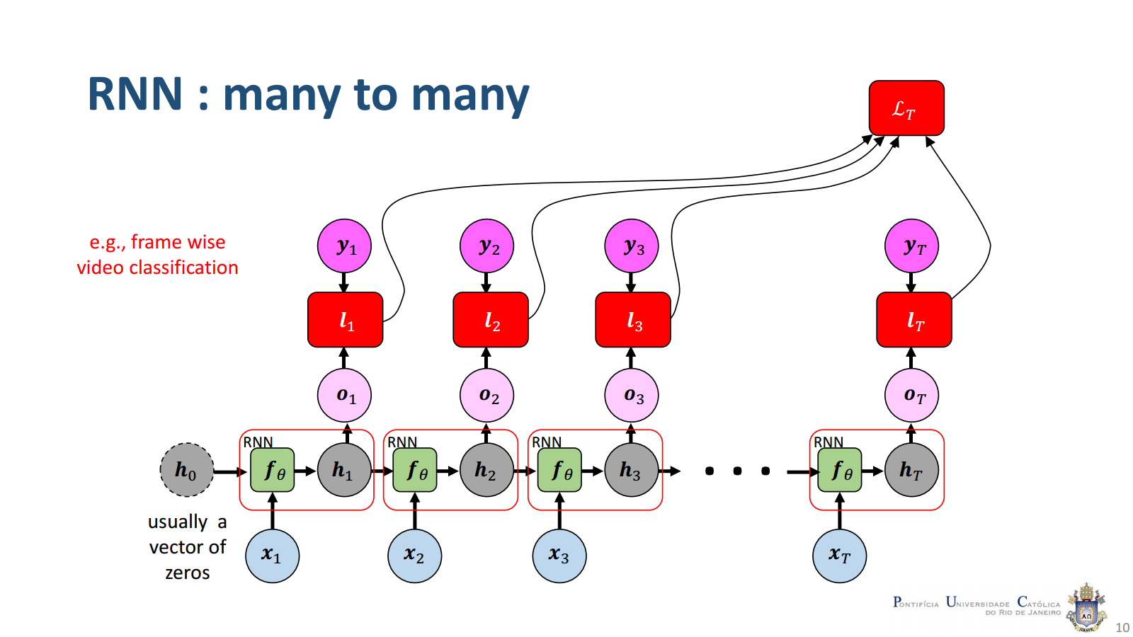

Slide 27
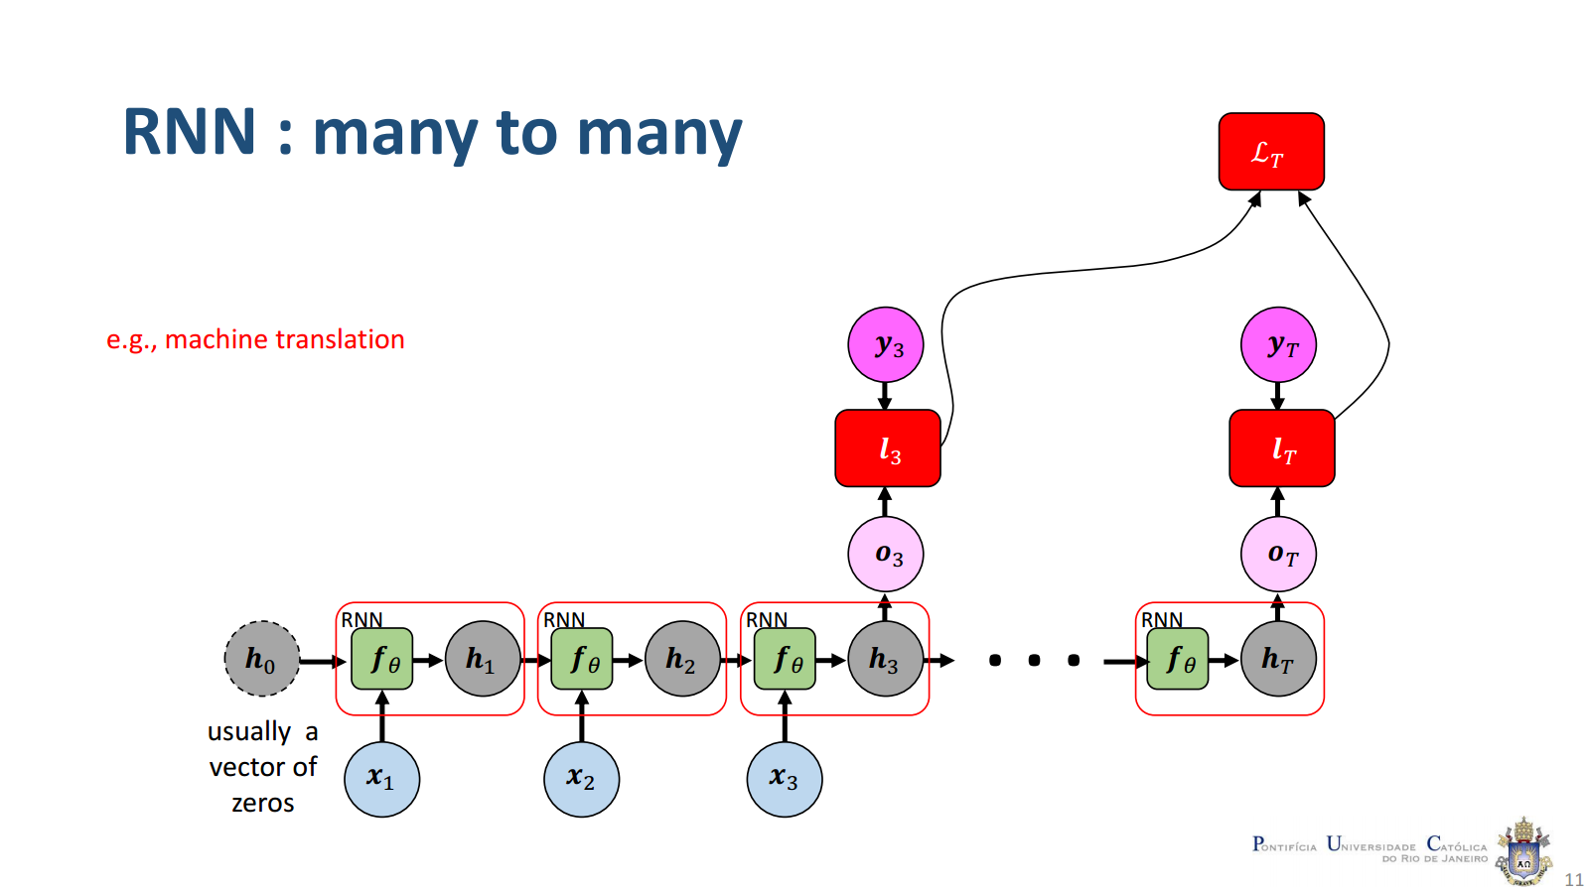

Slide 28
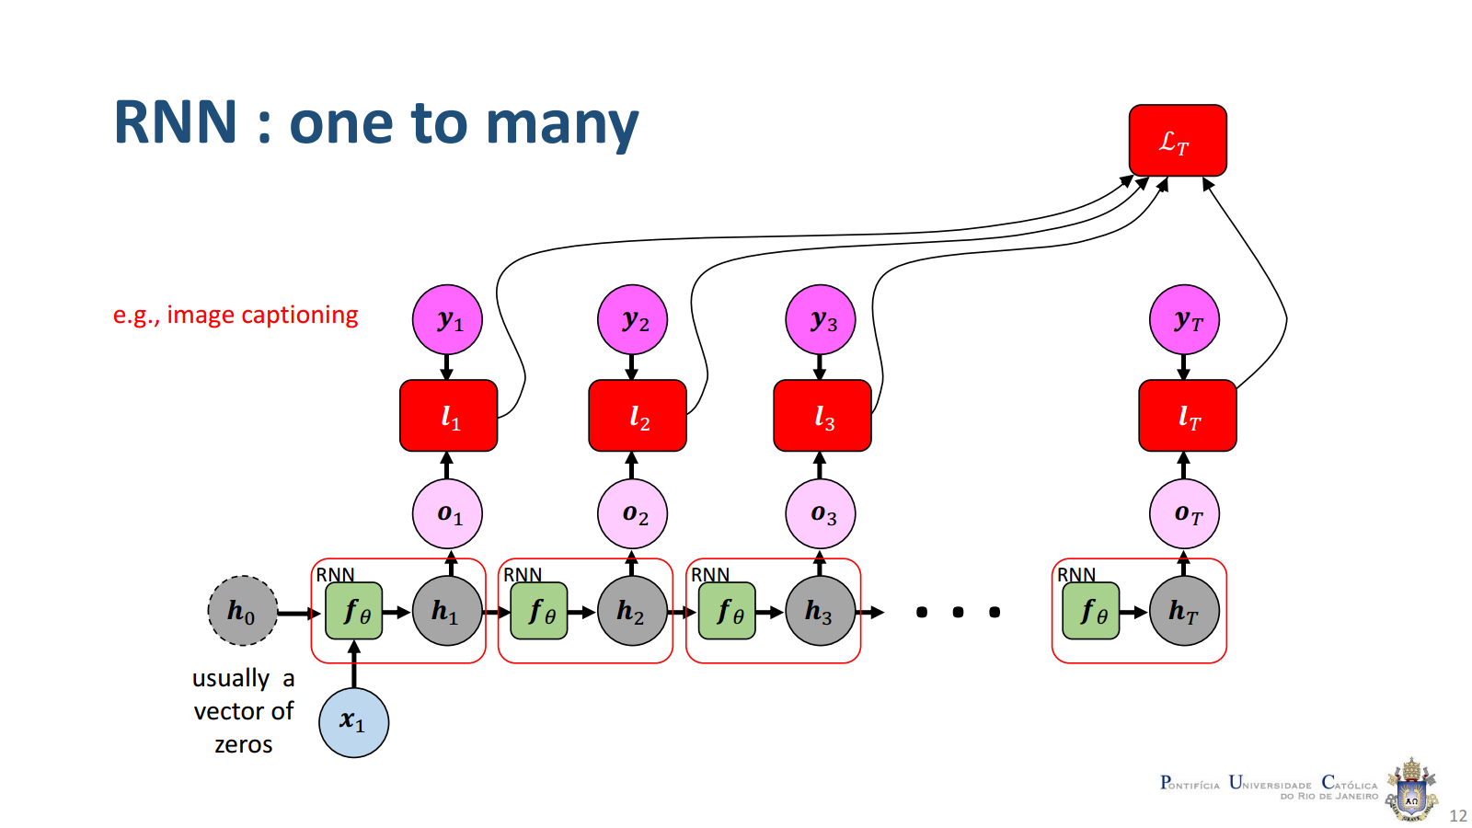

Slide 29
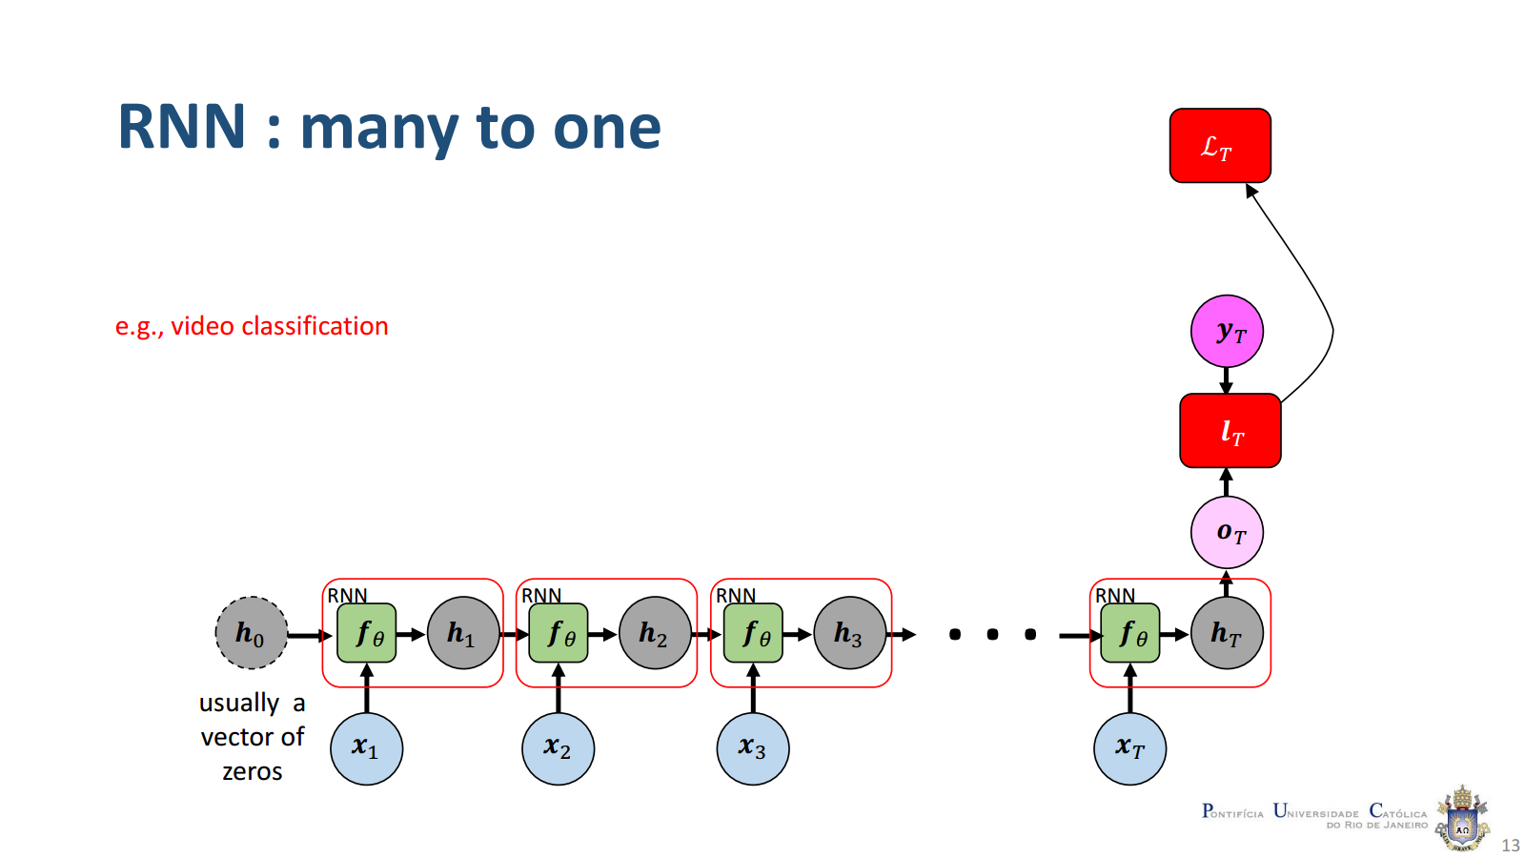

Slide 30
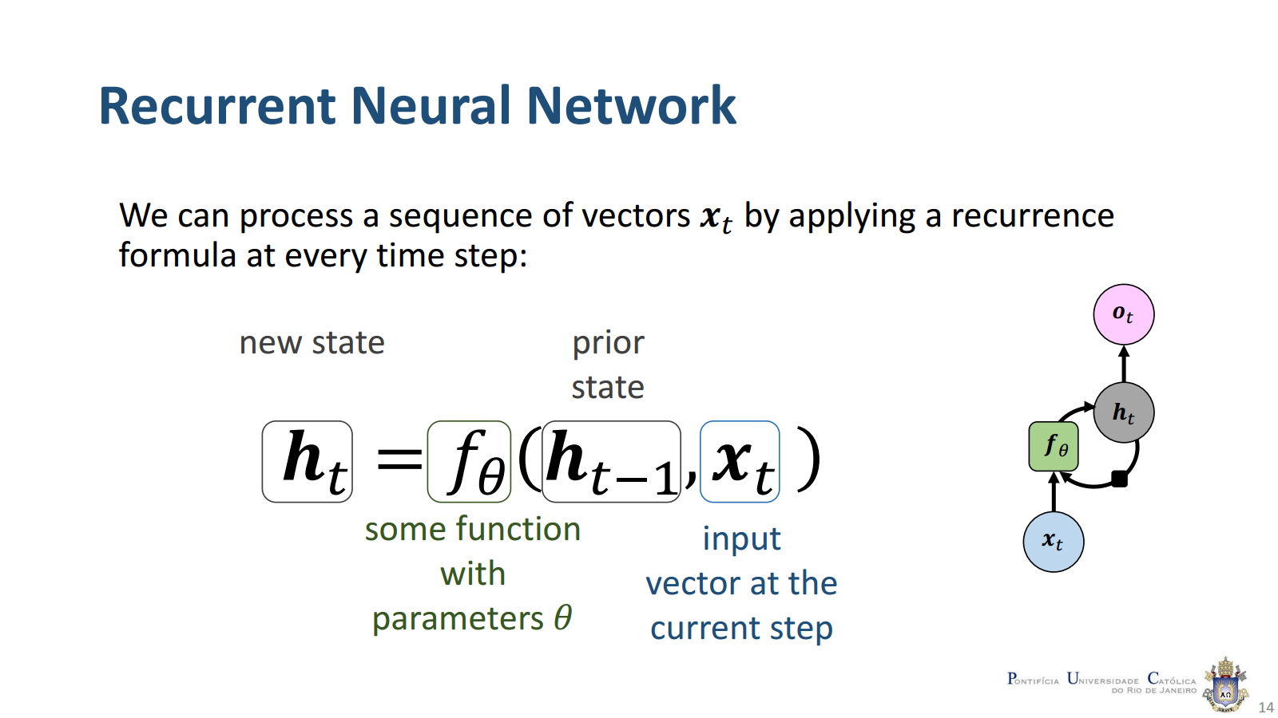

Slide 31
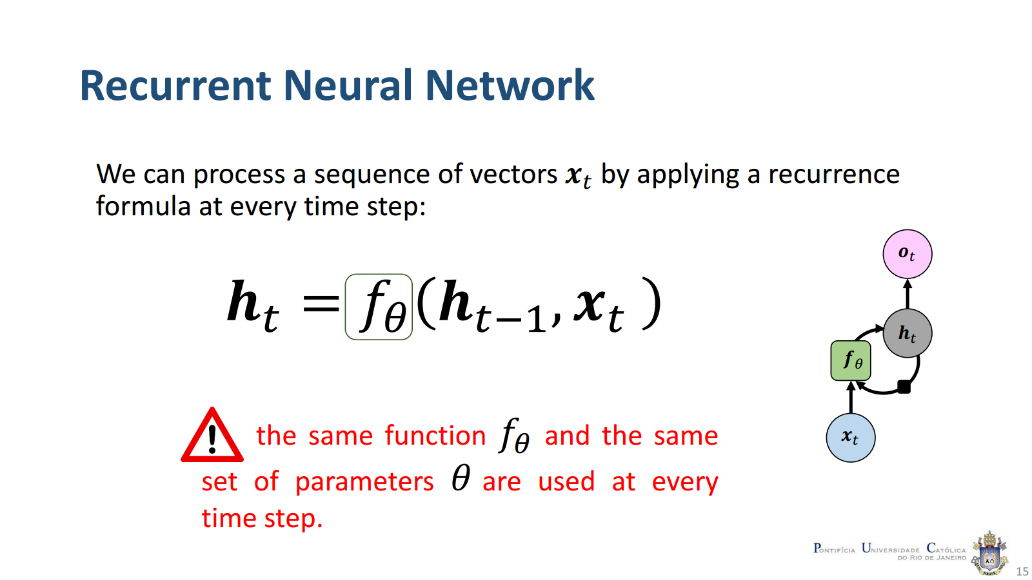

Slide 32
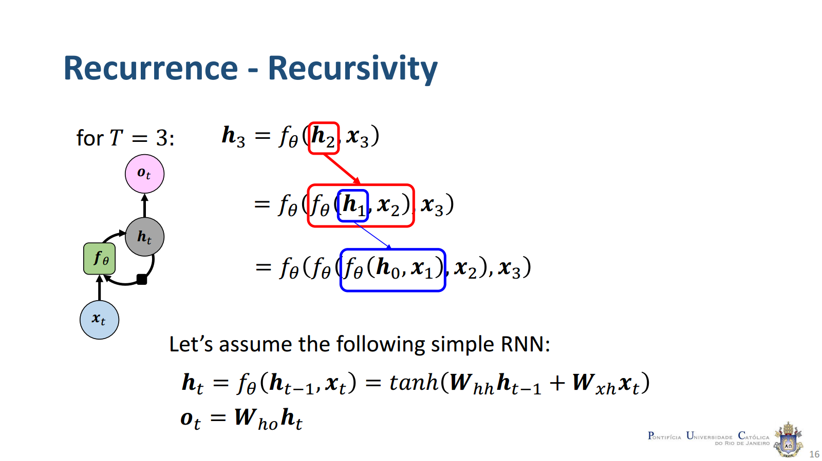

Slide 33
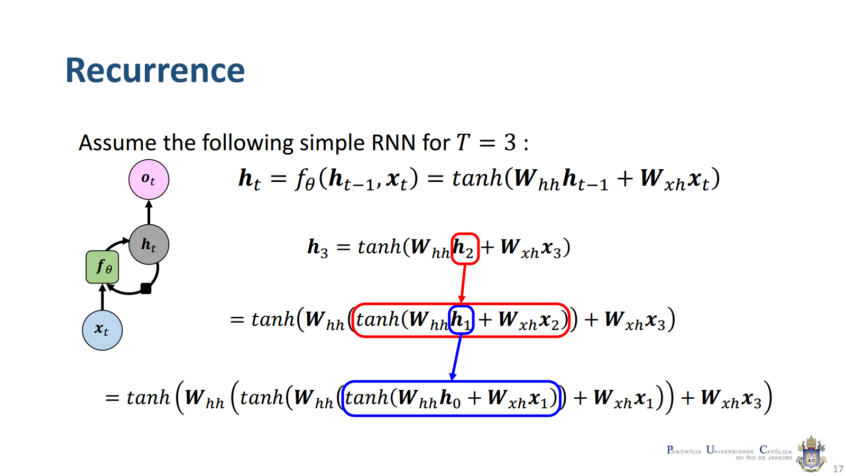

Slide 34
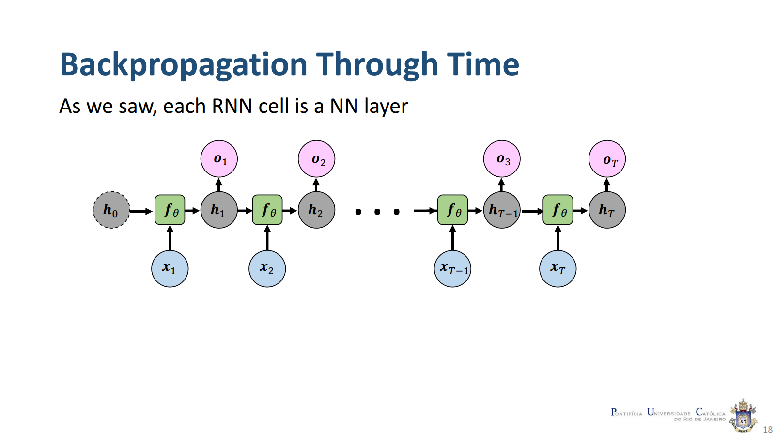

Slide 35
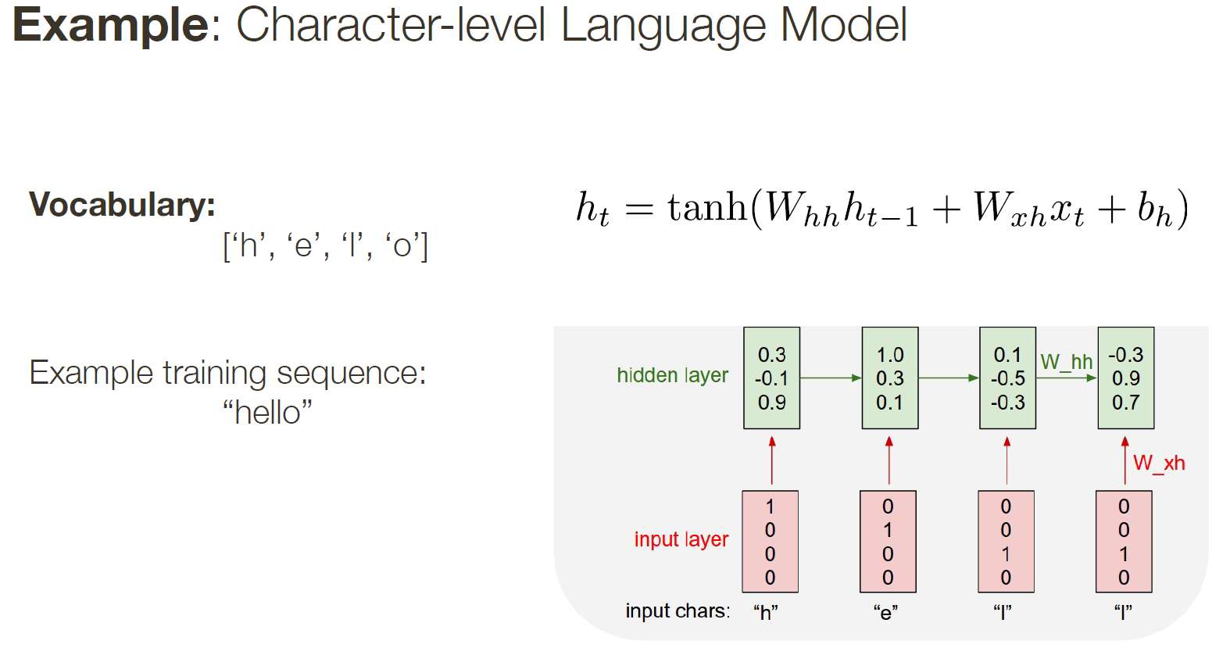

Slide 36
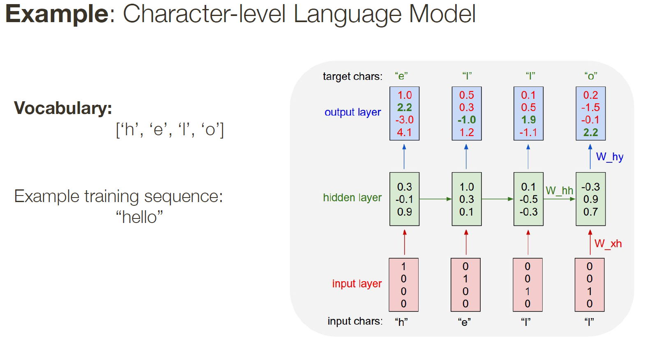

Slide 37
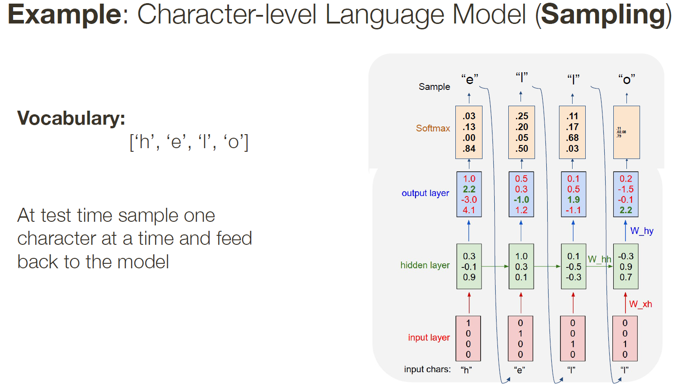
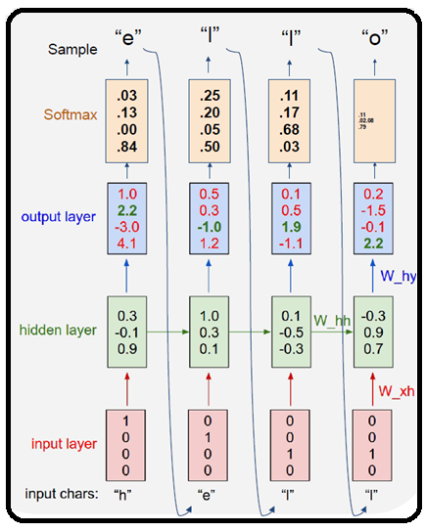

Slide 38
